Slide 1
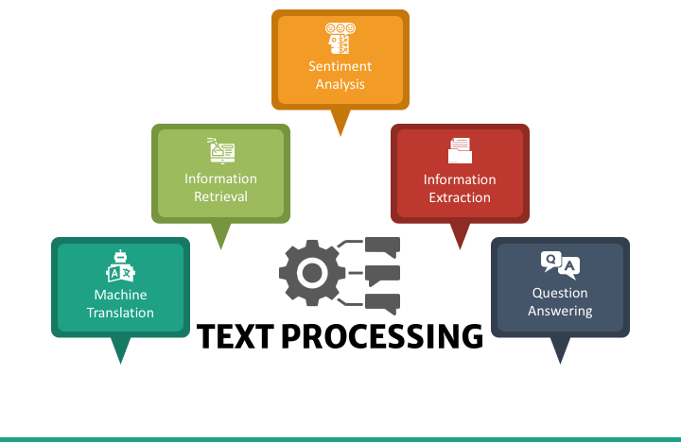

Slide 2
Text Documents
A text digital document consists of a sequence of words and other symbols, e.g., punctuation.
The individual words and other symbols are known as tokens or terms.
A textual document can be:
• Free text, also known as unstructured text, which is a
continuous sequence of tokens.
• Fielded text, also known as structured text, in which the text
is broken into sections that are distinguished by tags or other
markup. (e.g. csv, log files, json etc.)

Slide 3
What is Text?
Text is so common that we often ignore its importance
What is text?
Strings of characters (alphabets, ideograms, ascii, unicode, etc.)
Words
. , : ; - ( ) _
Σψμβολσ
1 2 3, 3.1415, 10¹⁰
f = ma, H₂0
Tables
Figures
Anything that is not an image, etc.
Why is text important?
Text is language capture
an instantiation of language, culture, science, etc.

Slide 4
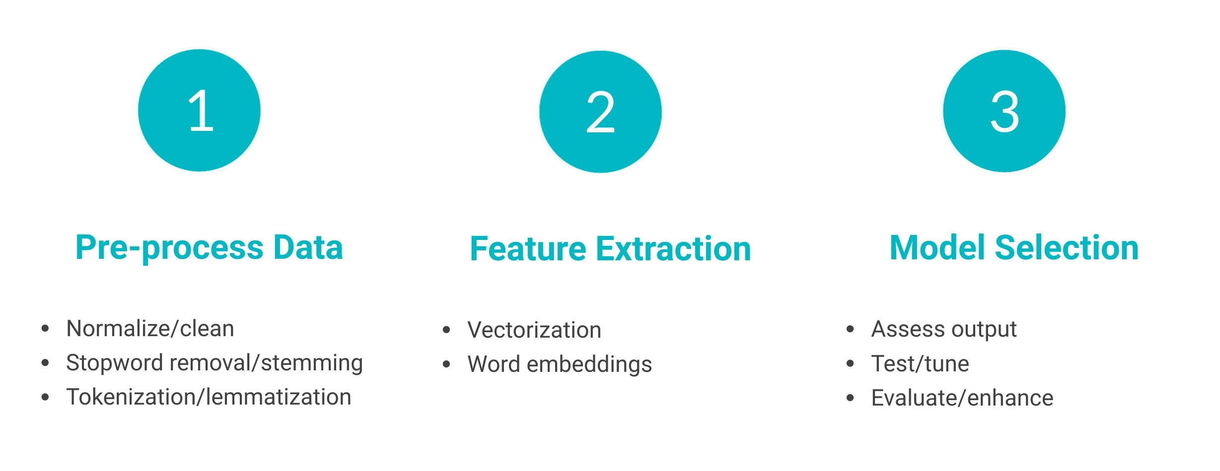
Textual Data Processing

Slide 5
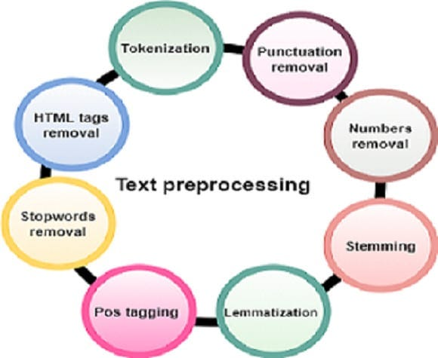
Preprocessing

Slide 6
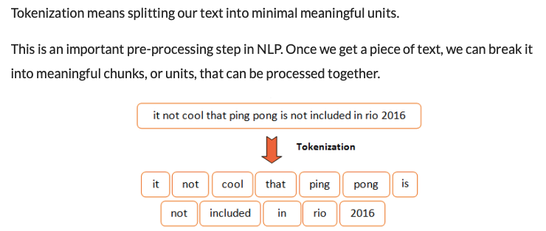
Tokenization

Slide 7
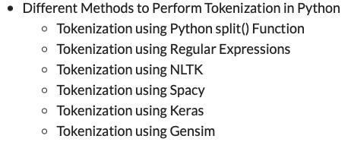
Lots of Tokenizers out there

Slide 8
Issues with Tokenization
Contractions:
Issue: Words like "don't" or "can't" contain apostrophes, and tokenizers might split them incorrectly.
Hyphenated Words:
Issue: Words connected by hyphens may be tokenized into separate words. E.g. “State-of-the-art technology”
Languages with No Spaces:
Issue: Some languages, like Chinese or Japanese, don't use spaces between words. E.g. 我喜欢学习自然语言处理

Slide 9
Issues with Tokenization
Language Issues
German noun compounds are not segmented
Lebensversicherungsgesellschaftsangestellter
Arabic (or Hebrew) is basically written right to left, but with certain items like numbers written left to right
URLs and Emails:
Issue: URLs or email addresses might be treated as single tokens, making it difficult to analyze them separately.

Slide 10
Punctuations and Numbers removal
Removing punctuation and numbers can be beneficial for certain tasks, such as sentiment analysis, text classification, or language modeling, where the focus is on the words themselves rather than numerical values or punctuation marks.
"There are 123 apples and 456 oranges in the basket.“
There are apples and oranges in the basket

Slide 11
Stemming
Stemming involves removing suffixes from words to obtain their root or base form. The result may not always be a valid word, but it aims to capture the core meaning of the word.
Common stemming algorithms include the Porter Stemmer and the Snowball Stemmer.
Words: Stemmed Words
Running Run
Flies Fli
Happily Happili
Cats Cat
Easily Easili

Slide 12
Typical rules in Porter
sses → ss
ies → i
ational → ate
tional → tion

Slide 13
Lemmatization
Lemmatization, on the other hand, involves reducing words to their base or dictionary form (lemma), which is a valid word.
Lemmatization typically involves looking at a word's meaning, context and POS to determine its base form.
The WordNet Lemmatizer is a common choice in NLP.
Words Lemmatized Words
Running Run
Flies Fly
Happily Happily
Cats Cat
Easily Easily

Slide 14
Key Differences
Output Form:
Stemming may result in non-words, as it focuses on removing suffixes.
Lemmatization results in valid words, as it aims to reduce words to their base or dictionary form.
Accuracy:
Stemming is a more aggressive normalization technique.
Lemmatization is a more accurate normalization technique but requires a dictionary or linguistic knowledge.

Slide 15
Part-of-speech (POS)
Part-of-speech (POS) tagging is a process in natural language processing (NLP) that involves assigning a grammatical category or part-of-speech label (such as noun, verb, adjective, etc.) to each word in a sentence.
POS tagging is essential for understanding the syntactic structure of text, and it serves
Here are some common part-of-speech categories:
Noun (NN): A word that represents a person, place, thing, or idea.
Verb (VB): A word that describes an action or occurrence.
Adjective (JJ): A word that describes or modifies a noun.
Adverb (RB): A word that describes or modifies a verb, adjective, or other adverbs.
Pronoun (PRP): A word that replaces a noun.
Preposition (IN): A word that indicates relationships between other words.
Conjunction (CC): A word that connects words, phrases, or clauses.
Determiner (DT): A word that introduces a noun and expresses reference to something specific.
Interjection (UH): A word or phrase expressing strong emotion.
as a foundation for various NLP tasks.

Slide 16
Part-of-speech (POS)
sentence = "The quick brown fox jumps over the lazy dog.“
[('The', 'DT'),
('quick', 'JJ'),
('brown', 'NN'),
('fox', 'NN'),
('jumps', 'VBZ'),
('over', 'IN'),
('the', 'DT'),
('lazy', 'JJ'),
('dog', 'NN'),
('.', '.')]

Slide 17
Stop Words
Stop words are common words that are often filtered out during text processing because they are considered to be of little value in terms of conveying meaningful information.
These words are extremely common across all texts and don't contribute much to the understanding of the content.
Examples of stop words include articles ("the," "a," "an"), prepositions ("in," "on," "at"), conjunctions ("and," "but," "or"), and common pronouns ("he," "she," "it").

Slide 18
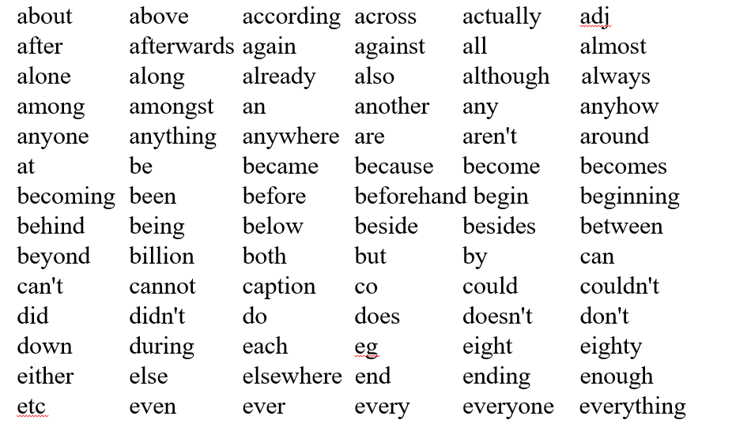
Example: the WAIS stop list (first 84 of 363 multi-letter words)
Notes:
The term "WAIS stop list" refers to the stop words list used in the Weighted Application Information System (WAIS). WAIS was one of the early systems for indexing and searching documents on the internet.

Slide 19
Feature Extraction in Natural Language Processing

Slide 20
Feature Extraction
In simple terms, Feature Extraction is transforming textual data into numerical data. In Natural Language Processing, Feature Extraction is a very trivial method to be followed to better understand the context.
After cleaning and normalizing textual data, we need to transform it into their features for modeling, as the machine does not compute textual data.
So we go for numerical representation for individual words as it’s easy for the computer to process numbers.

Slide 21
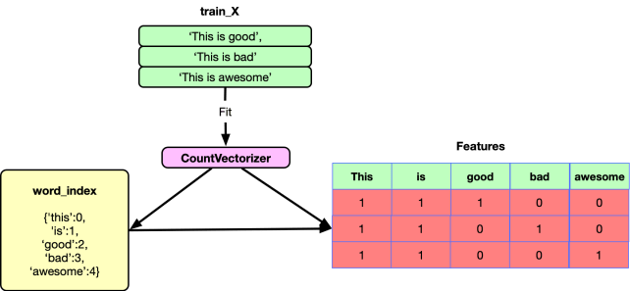
Count vectorizer

Slide 22
Count vectorizer
It is a simple and flexible way of extracting features from documents. A Countvectorizer model is a representation of text that describes the occurrence of words within a document.
We just keep track of word counts and disregard the grammatical details and the word order. It is called a “bag of words” because any information about the order or structure of words in the document is discarded.
The model is only concerned with whether known words occur in the document, not wherein the document.

Slide 23
from sklearn.feature_extraction.text import CountVectorizer
corpus = [“We become what we think about”, “Happiness is not something readymade. It comes from your own actions”]
# initialize count vectorizer object
vect = CountVectorizer()
# get counts of each token (word) in text data
X = vect.fit_transform(corpus)
# convert sparse matrix to numpy array to view
X.toarray()
# view token vocabulary and counts
print(“vocabulary”, vect.vocabulary_)
print(“shape”, X.shape)
print(‘vectors: ‘, X.toarray())

Slide 24
TF – IDF Vectorizer (Term Frequency – Inverse Document Frequency)
TF-IDF is short for term frequency-inverse document frequency. It’s designed to reflect how important a word is to a document in a collection or corpus.
The TF-IDF value increases proportionally to the number of times a word appears in the document and is offset by the number of documents in the corpus that contain the word, which helps to adjust for the fact that some words appear more frequently in general.

Slide 25
TF – IDF Vectorizer (Term Frequency – Inverse Document Frequency)
Term Frequency (TF):
Term Frequency measures how often a term (word) appears in a document.
It is calculated as the ratio of the number of occurrences of a term to the total number of words in the document.
Higher values indicate that a term is more frequent in the document.

Slide 26
TF – IDF Vectorizer (Term Frequency – Inverse Document Frequency)
Inverse Document Frequency (IDF):
Inverse Document Frequency measures how important a term is across multiple documents.
It is calculated as the logarithm of the ratio of the total number of documents to the number of documents containing the term, scaled by 1.
TF-IDF:
TF-IDF is calculated by multiplying the TF and IDF values.
It reflects how important a word is in a specific document relative to its importance across the entire corpus.

Slide 27
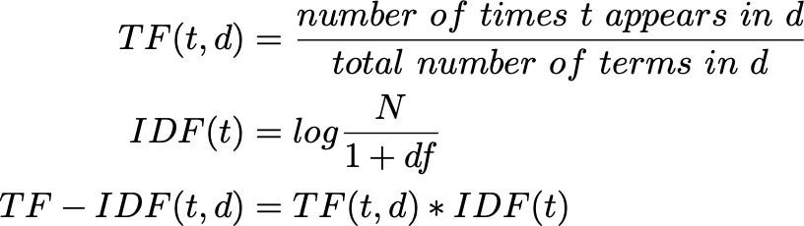
TF – IDF Vectorizer (Term Frequency – Inverse Document Frequency)

Slide 28
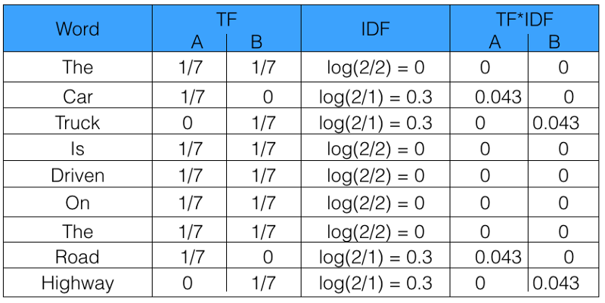
TF – IDF Vectorizer (Term Frequency – Inverse Document Frequency)
Sentence 1 : The car is driven on the road.
Sentence 2: The truck is driven on the highway.

Slide 29
from sklearn.feature_extraction.text import TfidfVectorizer
corpus = [“We become what we think about”, “Happiness is not something readymade.”]
# initialize tf-idf vectorizer object
vectorizer = TfidfVectorizer()
# compute bag of word counts and tf-idf values
tf = vectorizer.fit_transform(corpus)
# convert sparse matrix to numpy array to view
print(“Vocabulary”, vectorizer.vocabulary_)
print(“idf”, vectorizer.idf_)
print(“Vectors”, tf.toarray())

